Slide 1
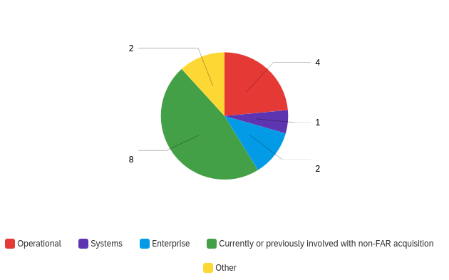
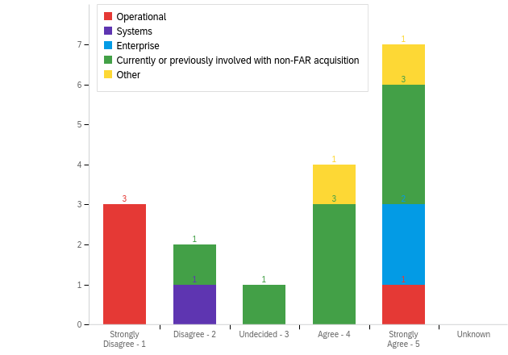
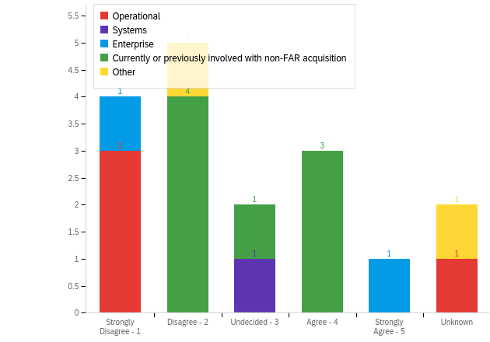
Non-FAR-based Contracts and Acquisition Environmental Factor Analysis
Abstract
Strategic competitors like China have the ability to sprint through technological hurdles by disregarding intellectual property laws and can decide when contractors will work with the government. Meanwhile the U.S. remains tied down by regulation, laws, and bureaucracy. To help alleviate these barriers, acquisition offices are turning to non– Federal Acquisition Regulation- (FAR) based procurement. Other transactions and additional non–FAR-based acquisition represent an area of contracting that personnel are seeking out but do not understand. The environmental factors that lead these non–FAR-based acquisition offices to success are also shrouded in mystery. Interviews of personnel in organizations that do FAR-based acquisition and in organizations that do non–FAR-based acquisition brought to light environmental factors at play. The interviews produced quantifiable data highlighting a large gap in training with fewer than half of non–FAR-based contracting respondents having training available to them and fewer than half of finance and requirement owners knowing non–FAR-based acquisition laws and regulations. Data also showed a drive from leadership for legal, finance, and contracting personnel to work together as a team. Continued importance must be placed on acquisition teams to find risk-appropriate deregulated solutions. Training and education should also be a main priority to educate personnel on what non–FAR-based procurement and contracting is how to do it properly.
Methods
Conducted pre-interviews to identify key environmental factors present in non-FAR based acquisition offices.
Utilized these key environments to develop 10 data driven interview questions.
Interviewed Contracting personnel across 5 categories to identify whether or not these factors were present for FAR and non-FAR based offices.
Questionnaire Experiential Breakdown
Results
Recommendations
A majority of respondents “agreed” their organization and other organizations are interested in non-FAR except for operational which 75% responded with disagrees.
Half of respondents trusted their requirement owners and financial manager with non-FAR laws and regulations.
A majority of respondents “agreed” leadership encouraged COs making decisions at the lowest level possible and pushed them to work with their finance, legal, and requirement owners.
Air Force Acquisition personnel need to be educated on when non-FAR is appropriate. While they may be aware they do not know when and how to utilize non-FAR.
Training programs need to be developed by the Air Force and DAU. Only one DAU course currently exists and its specifically for Other Transactions.
A continued emphasis needs to be placed on the opportunities provided by non-FAR to keep up with near peers/strategic competitors.
Increase non-FAR educated personnel and Agreement Officers to keep up with growing demand of non-FAR based acquisitions.
Q7: Other organizations on the installation have expressed interest in non-FAR based acquisition.
Q8: The contracting organization offers training in non-FAR acquisition
Acquisition Research Program
www.acquisitionresearch.net
Peter Barringer, Capt, USAF
Craig Miles, Capt, USAF
Student, Rank, Service
Advisors: Dr. Robert Mortlock
Reader: Rene Rendon

