Slide 1
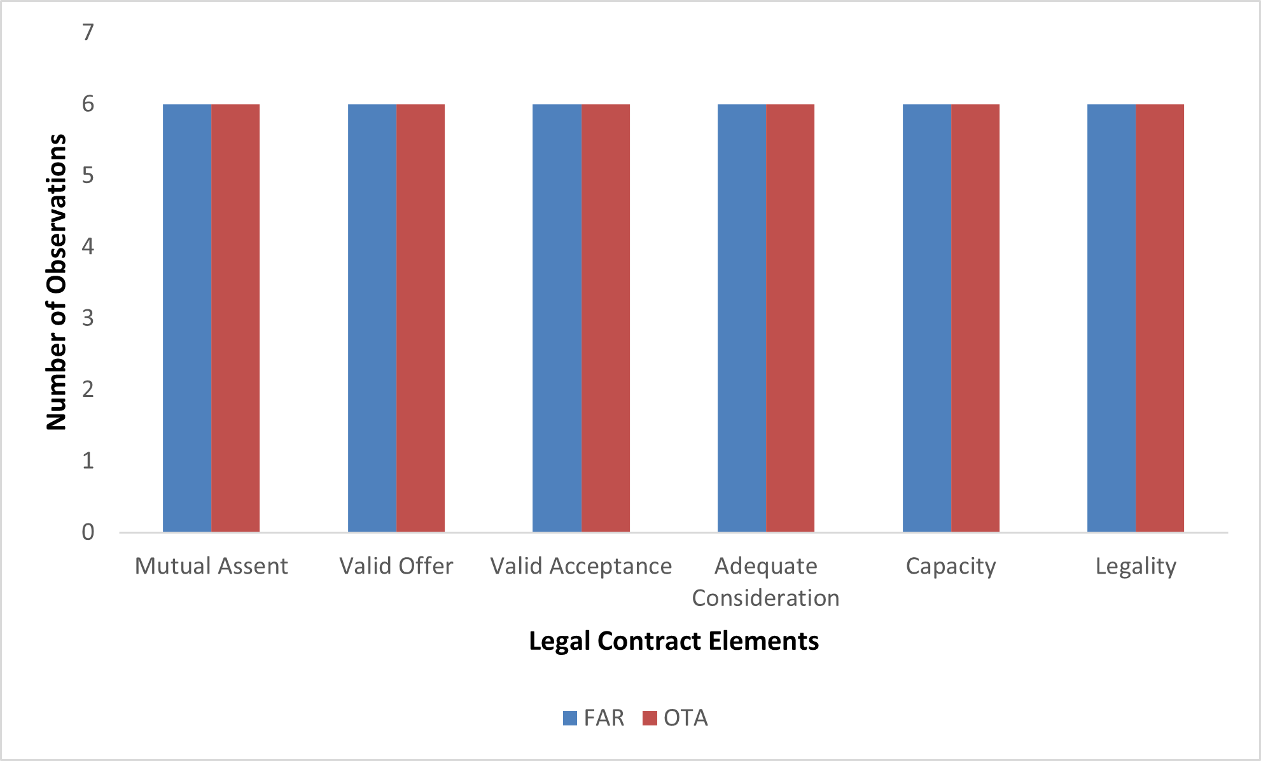
UNVEILING THE DISTINCTIONS: A DESCRIPTIVE AND COMPARATIVE STUDY OF OTHER TRANSACTION AUTHORITY AGREEMENTS AND FEDERAL ACQUISITION REGULATION–BASED CONTRACTS IN GOVERNMENT ACQUISITIONS
Abstract
This research presented an exploratory comparative analysis comparing Other Transaction Authority agreements and Federal Acquisition Regulation contracts to address the lack of comprehensive understanding between these two procurement mechanisms. There is a critical need to bridge the knowledge gap between OTA agreements and FAR-based contracts as their evolving use had hindered processes for government agencies and contractors. Through a descriptive analysis, this study aimed to uncover the similarities, differences, advantages, and limitations between OTA agreements and FAR-based contracts to inform decision-making and improve efficiency in government procurement.
The Adaptive Acquisition Framework
Methods
Collected six sets of FAR-based contracts and OTA agreements from 2010-2020.
Used mixed methods approach involving qualitative content analysis to compare contract language and systematic quantitative comparison of matched pairs.
Created an Excel dataset for each contract and capturing attributes like contract type, value, industry code, and presence/absence of key elements.
Paired FAR-based contracts and OTAs for evaluation based on dollar value ranges and industry codes.
Results & Their Impact
Legal Contract Elements Observations by Contract Type
UCF Section Observations by Contract Type
Both FAR-based and OTA contracts universally complied with legal elements of contract formation.
At the macro-level, OTA agreements exhibited greater variability in adherence to UCF sections compared to FAR-based contracts.
Micro-level paired comparisons revealed gaps in OTA language regarding deliverables, acceptance criteria, and data rights versus more prescriptive FAR contracts.
The findings offer insights to enable more informed decision-making on appropriate contract vehicles.
Acquisition Research Program
www.acquisitionresearch.net
Nicole Hall, Capt, USAF
Ryan Schnepf, SMSgt, USAF
Advisors: Lt Col Daniel Finkenstadt
Lt Col Jamie Porchia

