Slide 1
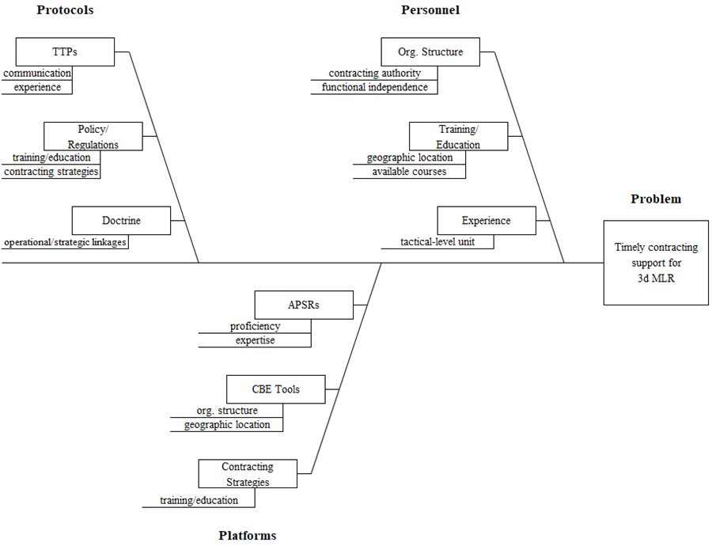
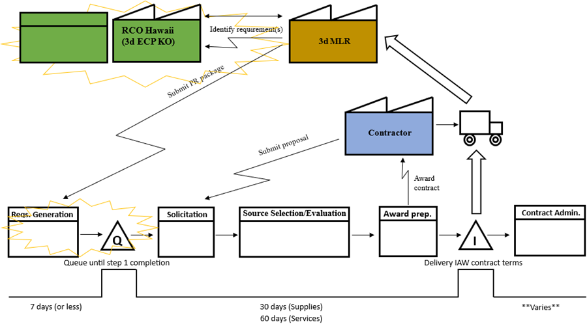
Sustainment of Stand-in Forces: Analysis of Contracting Capabilities in Support of 3d Marine Littoral Regiment
Abstract
Methods
The purpose of this Master of Business Administration professional project is to explore challenges in, and possible process or product improvements to, contracting support for stand-in forces such as 3d Marine Littoral Regiment (3d MLR). Operational contract support (OCS) and contingency contracting play a crucial role in providing nonorganic support to units training for and operating in contested environments. This study reviews the potential impact of current force initiatives and emerging concepts on the logistical planners and contracting facilitators of stand-in forces.
A literature review of current research and other published works on the topics of OCS and contingency contracting informs the project and identifies areas for exploration. The project utilizes Yoder’s Three Integrated Pillars for Success (TIPS) model as the underpinning theoretical framework from which process analysis is performed. The principles of lean thinking are applied to value stream mapping and root cause analysis of qualitative data gathered over the course of the study.
Value Stream Map: 3d MLR Contracting Process
Root Cause Analysis: Fishbone Diagram
Results & Their Impact
Recommendations
Contracting capabilities are not integrated within 3d MLR due to constraints of functional independence and contracting authority.
The current organizational structure of 3d MLR and its contracting enablers does not adequately support stand-in force or EABO operating concepts.
Requirements generation is the most significant barrier to providing timely contracting support.
3d MLR has not established the necessary linkages to fully exploit operational- and strategic-level OCS capabilities.
Collocate contracting officers with warrant authority delegated by 3d ECP at the Marine Corps Base Hawaii RCO.
Ensure 3d MLR contracting is incorporated into Phase Zero planning activities.
3d MLR planners and staff seek additional OCS training or contracting-related resources to gain expertise and enhance proficiency.
Recommendations and DOTmLPF-P Matrix
Acquisition Research Program
www.acquisitionresearch.net
Matheu Weaver, Capt, USMC
Advisors: Prof. Kelley Poree
Dr. Robert Mortlock

